Slide 1
University of Diyala
College of Engineering
Department of Architecture
1ST Stage
2018 – 2019
Lecture_ 01

Slide 2
العناصر الأولية في التصميم
Primary Elements in Design
الحجم
المستوي
الخط
النقطة
Volume
Plane
Line
Point

Slide 3
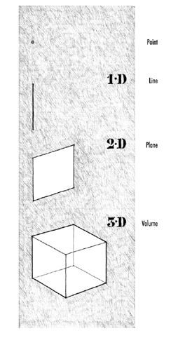
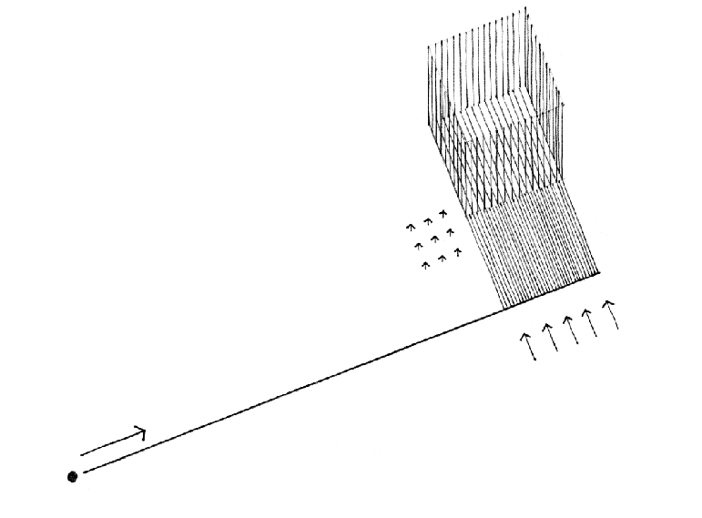
As the prime generator of form, the Point indicates a position in space.
•A point extended becomes a Line with properties of:
• length
• direction
•position.
A line extended becomes a Plane with properties of:
length and width
Shape
Surface
Orientation
Position
A plane extended becomes a Volume with properties of:
length, width, and depth
form and space
surface
orientation
position

Slide 4
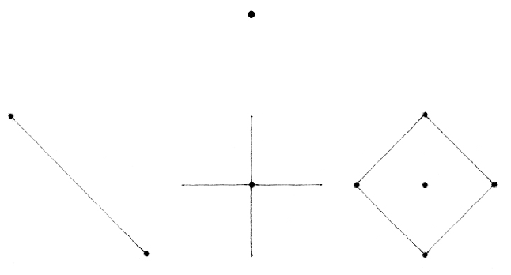
A point marks a position in space. Conceptually, it has no length, width, or depth, and is therefore static, centralized, and directionless.
As the prime element in the vocabulary of form, a point can serve to mark:
• the two ends of a line.
• the intersection of two lines.
• the meeting of lines at the corner of a plane or volume.
• the center of a field.

Slide 5
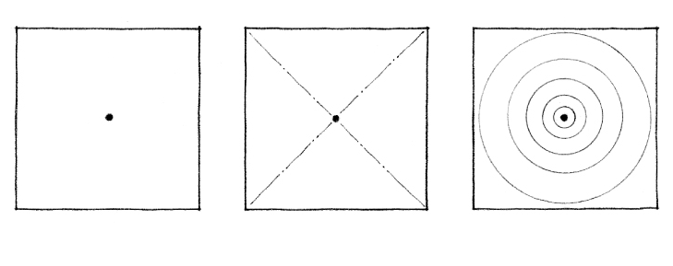
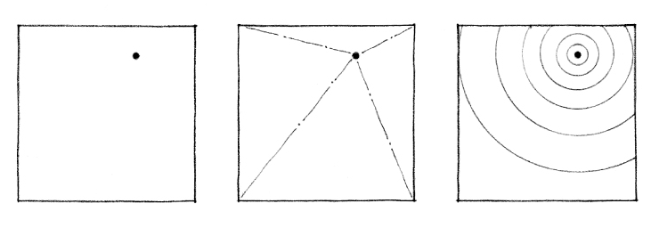
Although a point theoretically has neither shape nor form, it begins to make its presence felt when placed within a visual field. At the center of its environment, a point is stable and at rest, organizing surrounding elements about itself and dominating its field.
When the point is moved off-center, however, its field becomes more aggressive and begins to compete for visual supremacy. Visual tension is created between the point and its field.

Slide 6
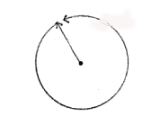
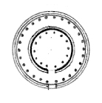
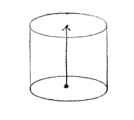
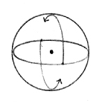
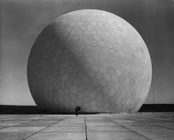

Slide 7
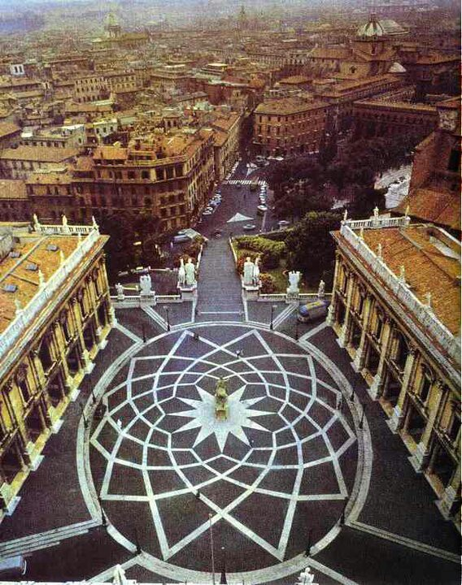

Slide 8
Two Points:
Two points describe a line that connects them. Although the points give this line finite length, the line can also be considered a segment of an infinitely longer path.

Slide 9
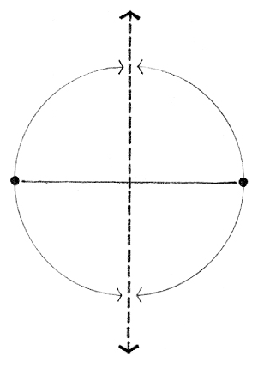
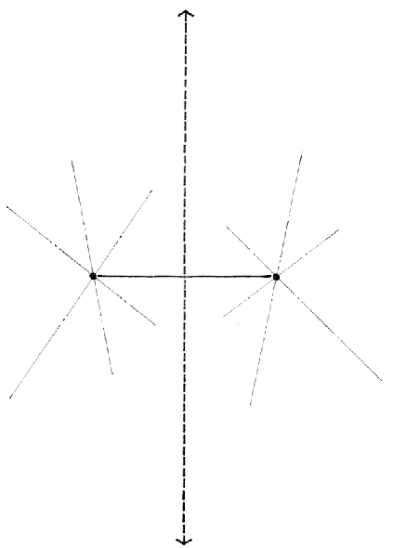
Two points further suggest an axis perpendicular to the line they describe and about which they are symmetrical. Because this axis may be infinite in length, it can be at times more dominant than the described line.
In both cases, however, the described line and the perpendicular axis are optically more dominant than the infinite number of lines that may pass through each of the individual points.

